Slide 1
Improving Iteration, Maintainability, and Analytics in the Build Pipeline
Austin Captivate Conference 2014

Slide 2
The Problems
Speed
Cross-platform Support
IDE Integration
Maintainability
“Black-box” mentality
  Poor visibility on what’s happening, when
  Poor communication about problems
  Little to no ability to analyze, understand, and improve the build process
  Ties into maintainability

Slide 3
Introducing CSBuild
Framework for discussion: CSBuild
  These techniques learned while creating CSBuild
  Provides a reference implementation of discussed techniques
  Open-source, freely available under MIT license

Slide 4
Problem: Speed

Slide 5
Problem: Speed
C/C++ is a slow language to compile
Templates make things much worse
C++ standard library is all templates – STL = Standard Template Library

Slide 6
Speed: Existing Solutions

Slide 7
Speed: Existing Solutions
Incredibuild/distcc
  Requires large distributed network
  Uses developers’ CPU resources in the background
  Linking is a bottleneck

Slide 8
Speed: Existing Solutions
CCache
  Prone to difficult-to-solve errors if the build is aborted
  Precompiled headers pose a difficulty
  Builds that can’t use cache are slower

Slide 9
Speed: Existing Solutions
Precompiled Headers
  Don’t always improve speed
  Can even make things slower
  Difficult to set up and use
  Inconsistent usage across toolchains

Slide 10
Speed: Existing Solutions
“Unity” Builds
  “Classic” unity build is always a full build
  “Classic” build not viable for large projects
  Splitting to multiple files still slows iteration
  Managing these files is a pain point

Slide 11
Speed: Existing Solutions
Ninja
  Speed derived from two factors:
    Make fewer decisions
    Maximize parallelism
  Sacrifices elsewhere – generally requires a generator (i.e., CMake) to create ninja files

Slide 12
Speed:
Iterating on the Solutions

Slide 13
Speed:
Iterating on the Solutions
Use “Chunked” builds
  Improvement on Unity builds to achieve fast full builds and fast iteration
  Chunks are created and destroyed based on build context
    Always shoot for maximum parallelism. If all threads not used, split up the chunk!
  Created based on ideal filesize

Slide 14
Speed:
Iterating on the Solutions
“Chunked” Builds
  Downsides:
    Static symbol redefinition
    Header fall-through
    Creates an explicit initialization order of global objects that doesn’t exist when not chunking, possibly masking bugs
  Chunk control is a necessity – disable and manage per file and for the whole build

Slide 15
Speed:
Iterating on the Solutions
Absolutely Maximize Parallelism
  Be parallel by default
  Cross-project, cross-target, cross-architecture – everything builds parallel
  Don’t stop compiling to link
  Parallel link only when all compiles have finished
    Linking is expensive
  Provide thread count control; some systems can’t handle using them all

Slide 16
Speed:
Iterating on the Solutions
Use Intelligent Change Detection
  Use MD5 checksum, not just modification date
    MD5 collisions are rare enough that the chance of this happening on a change are negligible
  Strip comments
  Strip whitespace
  End result: Only build what actually changes

Slide 17
Speed:
Iterating on the Solutions
Let developers improve their own builds
  Provide as much information to the developer as possible
  Give the developer as much control as possible
  Understanding + Power = Whole Pipeline Improvement
  More on this later

Slide 18
Speed Results:
CSBuild’s implementation
Full build time:
  Large project built on Windows using msvc toolchain
  Visual Studio: _:__
  Ninja: _:__
  CSBuild: _:__
Incremental builds time are rapidly changing with current development.
  With gcc/clang toolchain, times are fast
  With msvc, first iteration is slower when incremental linking is enabled
    Researching ways to improve this
6:46
7:10
2:33

Slide 19
Problem:
Cross-Platform Support

Slide 20
Problem: Cross-Platform Support
Many toolchains are platform-specific
Compilers don’t share a common interface
Market is evolving – one platform isn’t enough
Mobile space complicates matters
For cross-platform systems, adding new platforms is often difficult.

Slide 21
Problem: Cross-Platform Support
Some platforms see particularly poor support
  Consoles
    Expected given the nature of console development
  Android
    Systems that support android only support it partially, or aren’t maintained
    Many require cygwin to be installed
    This makes android development particularly painful
    Tegra toolkit is the best current solution

Slide 22
Cross-Platform Support: Existing Solutions

Slide 23
Cross-Platform Support:
Existing Solutions
Generators
  Cmake
  Premake
  GYP
Builders
  Jam/Boost.Build
  SCons
  Ninja

Slide 24
Cross-Platform Support:
Iterating on the Solutions

Slide 25
Cross-Platform Support:
Iterating on the Solutions
Support more platforms by default
Make it easy to set build settings per-platform
Provide a plugin system for platforms you don’t support
  Important for game developers – console NDAs prevent native support

Slide 26
Cross-Platform Support:
Iterating on the Solutions
CSBuild’s solution provides support for:
  Windows
  Linux
  Android NDK (Cygwin not required)
  MacOSX
  iOS

Slide 27
Problem:
IDE Integration

Slide 28
Problem: IDE Integration
Each IDE has a different project format
Native projects require heavy manual maintenance
  Changing a setting across multiple projects requires making the same change in many places
  Managing libraries and directories is worse – the same change in many slightly different places – inside lists containing different items in different orders
Many solutions require manual setup of IDE projects

Slide 29
IDE Integration:
Existing Solutions

Slide 30
IDE Integration:
Existing Solutions
Generators generate native projects – generation instead of integration
SCons includes visual studio integration, eclipse integration added by plugin
Jam, Ninja have no integration at all

Slide 31
IDE Integration:
Iterating on the Solutions

Slide 32
IDE Integration:
Iterating on the Solutions
Make your system both a generator and a builder
  Don’t just build. Don’t just generate. Integrate.
Generate “makefile” projects – maintain your other improvements
  Added benefit: regeneration not necessary to build when files are added or removed
Put multiple architectures and toolchains in just one solution
Provide plugin system to support new IDEs
When possible, mimic folder structure in IDE

Slide 33
IDE Integration:
Iterating on the Solutions
CSBuild’s solution currently provides native support for:
  Visual Studio
  QtCreator
  Next priority: XCode and Eclipse
    These environments are very popular, and very important to support

Slide 34
Problem:
Maintainability

Slide 35
Problem: Maintainability
Many discussed solutions offer poor syntax, steep learning curve, and poor readability
Writing build files is hard. Updating someone else’s files is harder.
Some systems offer more flexibility than others – some are very rigid.
Result: Many teams have the “One Build Guy” everyone relies on to maintain the build

Slide 36
Maintainability:
Existing Solutions

Slide 37
Maintainability:
Existing Solutions
Varying levels of maintainability between different solutions, but many aren’t great
Existing solutions do accomplish their goals, and most do so very well, but maintainability remains a problem in general
Systems that use a known language are generally better than those that use custom syntax

Slide 38
Maintainability:
Iterating on the Solutions

Slide 39
Maintainability:
Iterating on the Solutions
Use a language your users already know for your makefiles
  Simpler is better
  Abstract compiler details into readable functions, so users can build a makefile without knowing the compiler details
Give developers flexibility with their makefile organization
Provide clear delineation of projects
Provide an inheritance-based structure
Verify directories and libraries exist up-front
With gcc, make use of –Wl,-R to avoid LD_LIBRARY_PATH environment variable
Provide option to specify files to include or to exclude

Slide 40
Maintainability:
Iterating on the Solutions
CSBuild’s solution uses python as a makefile language
Projects are organized into functions with @project decorator
Inheritance achieved with global scope, project groups, and @scope decorator to pass settings down in various ways
Automatic file discovery is the default

Slide 41
Maintainability:
Iterating on the Solutions
import csbuild
csbuild.Toolchain("gcc", "android", "ios").SetCppStandard(“c++11”)
csbuild.Toolchain("gcc", "android").SetCcCommand(“clang”)
csbuild.Toolchain("gcc", "android”).SetCxxCommand(“clang++”)
csbuild.Toolchain("msvc").SetMsvcVersion(csbuild.toolchain_msvc.VisualStudioPackage.Vs2012)
csbuild.AddLibaryDirectories(“../3rdParty/lib”)
@csbuild.project(name="libMyLib", workingDirectory="libMyLib/src")
def libMyLib():
csbuild.Toolchain("msvc", “ios").SetOutput("libMyLib", csbuild.ProjectType.StaticLibrary)
csbuild.Toolchain("gcc", "android").SetOutput("libMyLib", csbuild.ProjectType.SharedLibrary)
#equivalent to CMake PUBLIC declaration
@csbuild.scope(csbuild.ScopeDef.All)
def AllScope():
csbuild.AddIncludeDirectories(
"libMyLib/include", "../3rdParty/include/SomeLib", "../3rdParty/include/OtherLib“
)
#equivalent to CMake INTERFACE declaration
@csbuild.scope(csbuild.ScopeDef.Final)
def FinalScope():
csbuild.AddLibraries("SomeLib", "OtherLib“)
@csbuild.project(name="myApp", workingDirectory="myApp/src", depends=["libMyLib"])
def myApp():
csbuild.SetOutput("myApp", csbuild.ProjectType.Application)
csbuild.AddIncludeDirectories("../3rdParty/include/AdditionalLib", "../3rdParty/include/YetAnotherLib“)
csbuild.AddLibraries("AdditionalLib“, "YetAnotherLib")

Slide 42
Maintainability:
Iterating on the Solutions
import csbuild
csbuild.Toolchain("gcc", "android", "ios").SetCppStandard(“c++11”)
csbuild.Toolchain("gcc", "android").SetCcCommand(“clang”)
csbuild.Toolchain("gcc", "android”).SetCxxCommand(“clang++”)
csbuild.Toolchain("msvc").SetMsvcVersion(
csbuild.toolchain_msvc.VisualStudioPackage.Vs2012
)
csbuild.AddLibaryDirectories(“../3rdParty/lib”)

Slide 43
Maintainability:
Iterating on the Solutions
@csbuild.project(name="libMyLib", workingDirectory="libMyLib/src")
def libMyLib():
csbuild.Toolchain("msvc", "ios").SetOutput(
"libMyLib", csbuild.ProjectType.StaticLibrary)
csbuild.Toolchain("gcc", "android").SetOutput(
"libMyLib", csbuild.ProjectType.SharedLibrary)
#equivalent to CMake PUBLIC declaration
@csbuild.scope(csbuild.ScopeDef.All)
def AllScope():
csbuild.AddIncludeDirectories(
"libMyLib/include",
"../3rdParty/include/SomeLib",
"../3rdParty/include/OtherLib“,
)
#equivalent to CMake INTERFACE declaration
@csbuild.scope(csbuild.ScopeDef.Final)
def FinalScope():
csbuild.AddLibraries("SomeLib", "OtherLib“)

Slide 44
Maintainability:
Iterating on the Solutions
@csbuild.project(
name="myApp",
workingDirectory="myApp/src“,
depends=["libMyLib"]
)
def myApp():
csbuild.SetOutput("myApp", csbuild.ProjectType.Application)
csbuild.AddIncludeDirectories(
"../3rdParty/include/AdditionalLib",
"../3rdParty/include/YetAnotherLib“,
)
csbuild.AddLibraries("AdditionalLib“, "YetAnotherLib")

Slide 45
Problem:
“Black-Box” Mentality

Slide 46
Problem: “Black-Box” Mentality
Build systems tend to exist in a vacuum – you put settings in, you get binaries out
Few tools available to help improve build processes or project structure
Problems with your build process in general – beyond warnings and errors generated by the compiler – are not well-understood or communicated

Slide 47
“Black Box” Mentality:
Existing Solutions

Slide 48
“Black Box” Mentality:
Existing Solutions
Popular systems generally don’t offer solutions.
Solutions that exist are not well integrated with other tools, and not widely adopted

Slide 49
“Black Box” Mentality:
Iterating on the Solutions

Slide 50
“Black Box” Mentality:
Iterating on the Solutions
Integrate existing disparate ideas into one tool
Provide as much information as possible
As readable as possible
When building on the command line:
  Colored log output
  Command-line progress bar
  Time reporting
  Current/total file counts

Slide 51
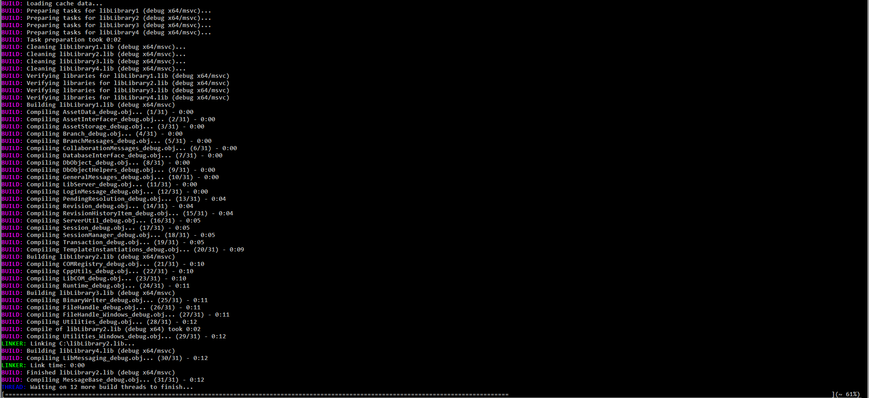
“Black Box” Mentality:
Iterating on the Solutions

Slide 52
“Black Box” Mentality:
Iterating on the Solutions
Provide tools for build monitoring
  Provide a build status GUI
  See what’s happening and when
  Progress bars – per project, per file
  Build times – per project, per file
  Current status – per project, per file
  Error and warning display
    Hierarchical
    Expandable, collapsible
    Filterable

Slide 53
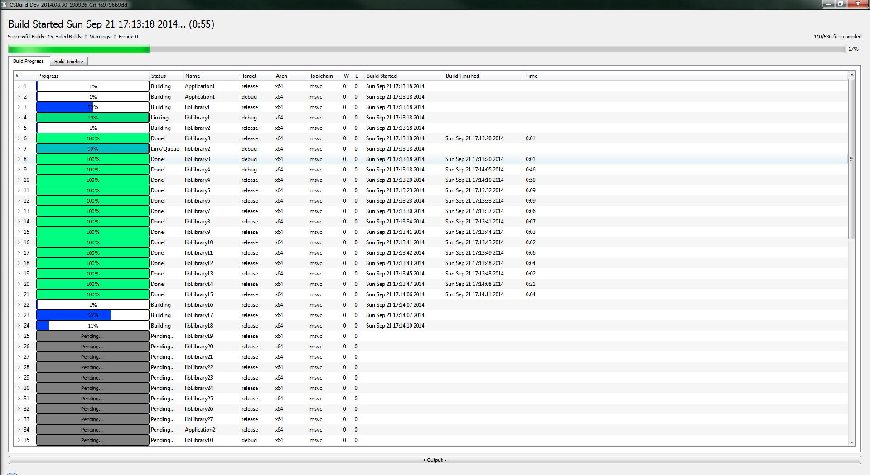
“Black Box” Mentality:
Iterating on the Solutions

Slide 54
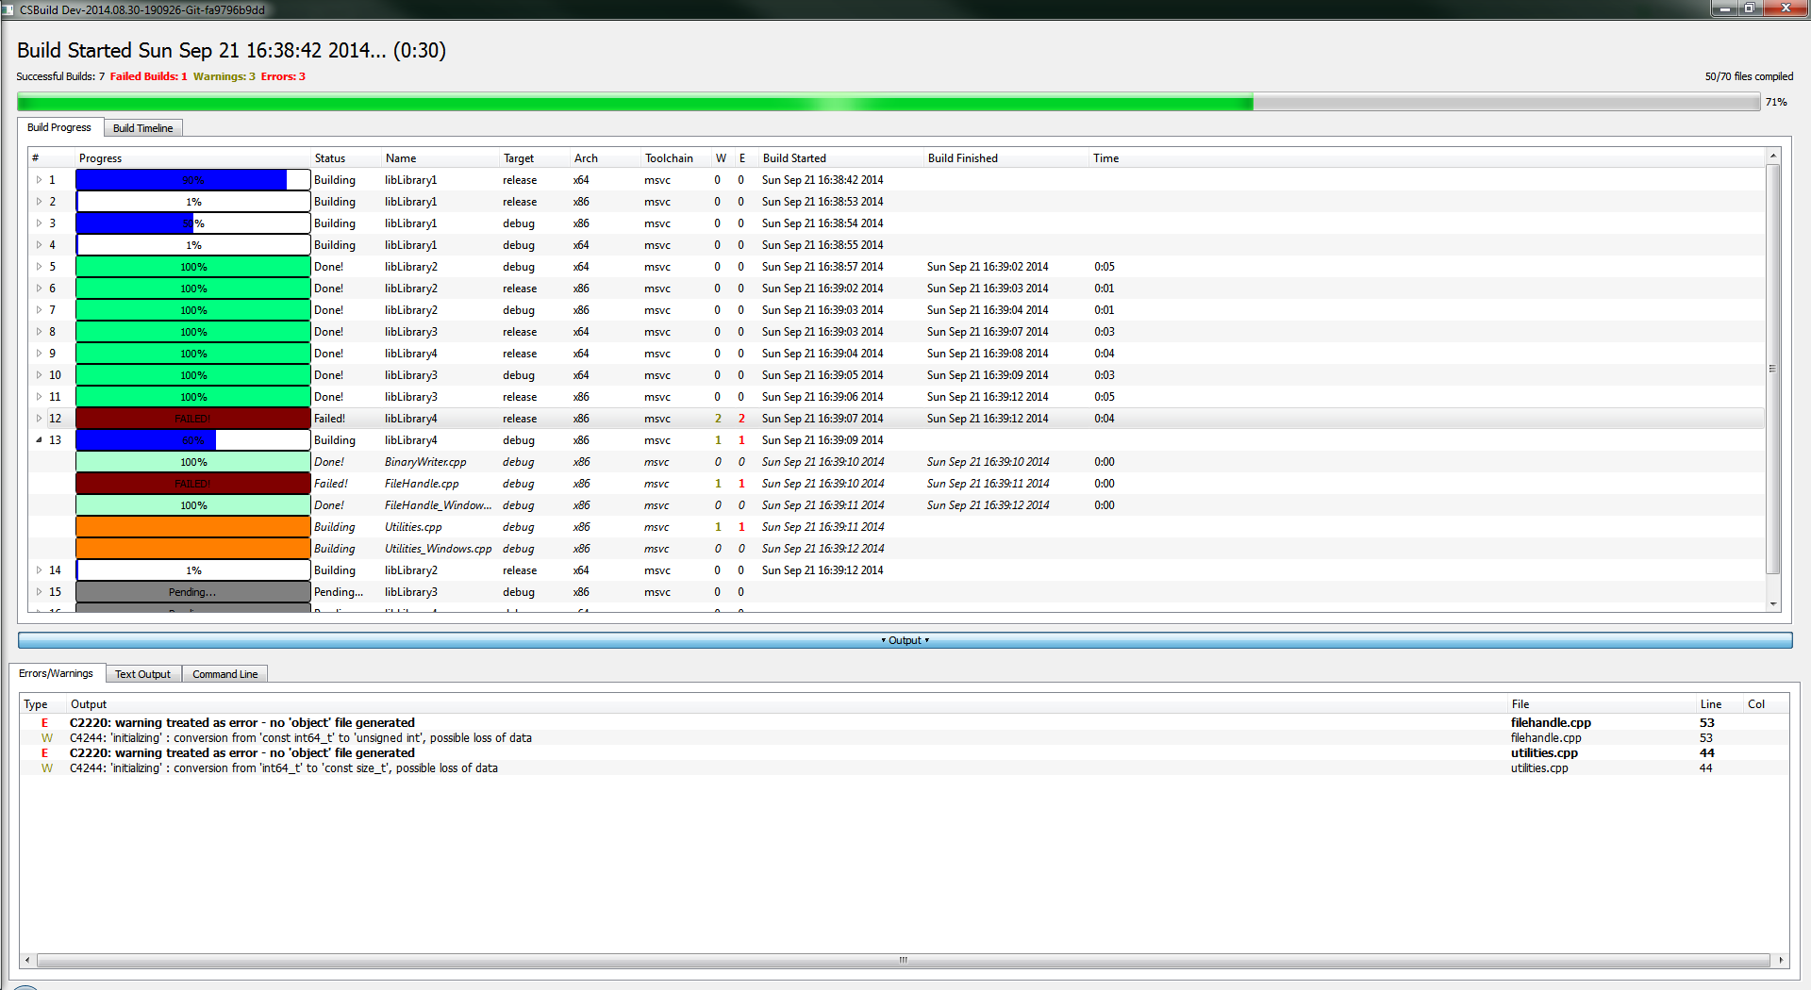
“Black Box” Mentality:
Iterating on the Solutions

Slide 55
“Black Box” Mentality:
Iterating on the Solutions
Why GUI?
  Actively shows progress in the build
  Reduces developer frustration while building
  More importantly, makes additional features possible
  Example: Built-in Code Editor
    Invaluable for cross-platform work, when you have no IDE set up. Instead of searching for the file, click to open, edit, and save.
  Most of the following examples rely on the GUI for functionality

Slide 56
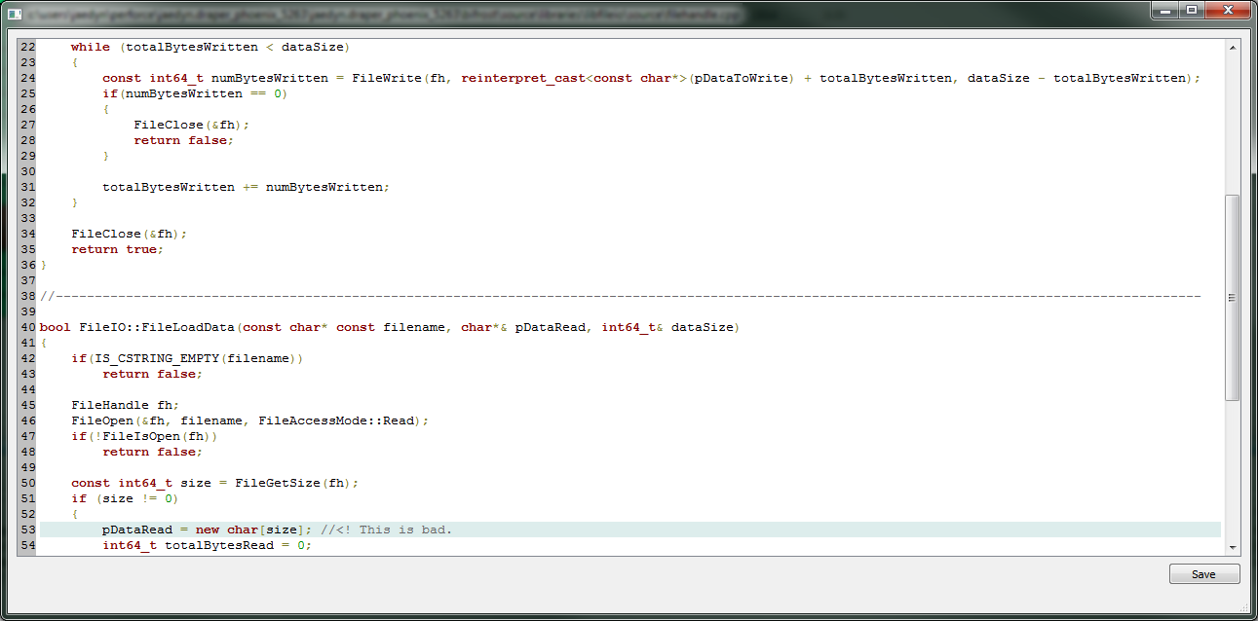
“Black Box” Mentality:
Iterating on the Solutions

Slide 57
“Black Box” Mentality:
Iterating on the Solutions
Provide tools for build analysis
  Example: Timeline View
    See what was happening and when
    Isolate slow builds and rearrange
    Example: In our project, rearranging build order of long builds cut down total build time by 50%

Slide 58
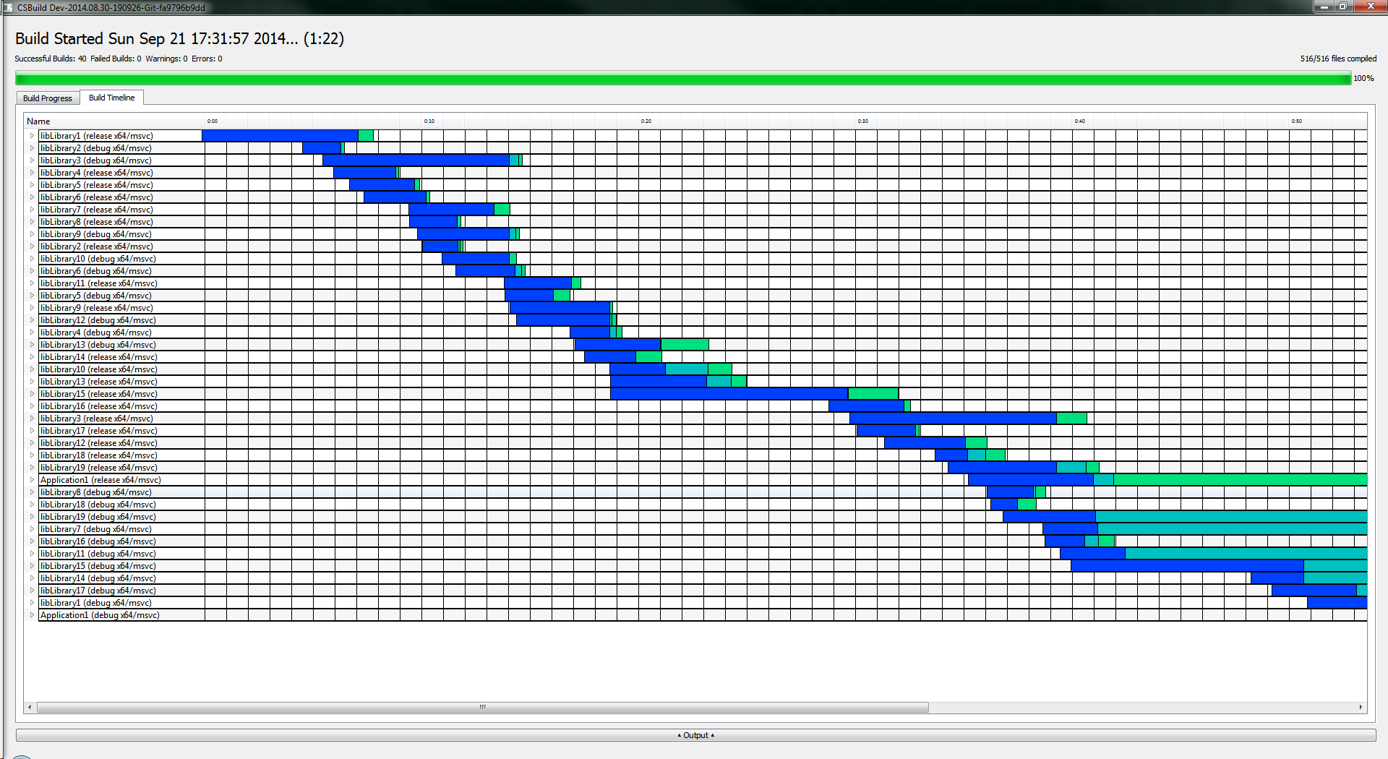
“Black Box” Mentality:
Iterating on the Solutions

Slide 59
“Black Box” Mentality:
Iterating on the Solutions
Provide a Line-By-Line Build Profiler
  We optimize code – why not also optimize builds?
  Examine individual files
  Locate lines that are slow to compile
  Locate heavy headers
    Identify opportunities to forward-declare
    Identify candidates for precompiled headers
  Makes keeping your builds clean and speedy much easier

Slide 60
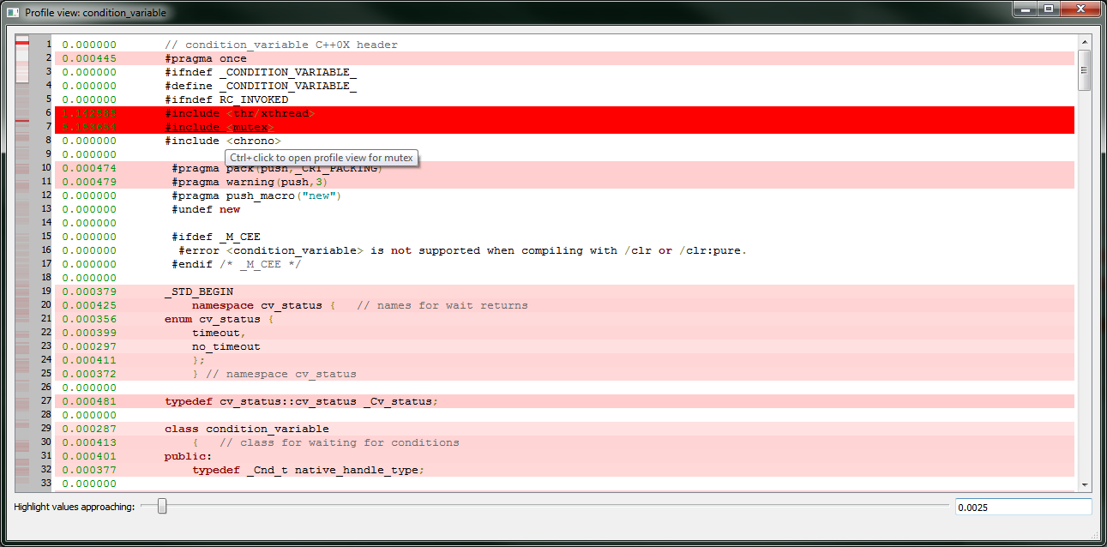
“Black Box” Mentality:
Iterating on the Solutions

Slide 61
“Black Box” Mentality:
Iterating on the Solutions
Build Profiler: How?
  Preprocess to file
  Open preprocessed file, and on each line, add compiler-appropriate #pragma message
  Time intervals between messages and swallow message output
  Caveat: The compiler spends additional time after processing the file, which is not accounted for
    Information is useful and actionable nonetheless

Slide 62
“Black Box” Mentality:
Iterating on the Solutions
Include Dependency Graph Generation
  Create dot file, leverage graphviz for rendering.
  “dot” algorithm is not very effective; “neato” algorithm is much better
    fdp and sfdp are decent as well
  Shows inter-project interactions
  Shows circular dependencies
  Allows you to improve project structure
  Better understanding = Better projects

Slide 63
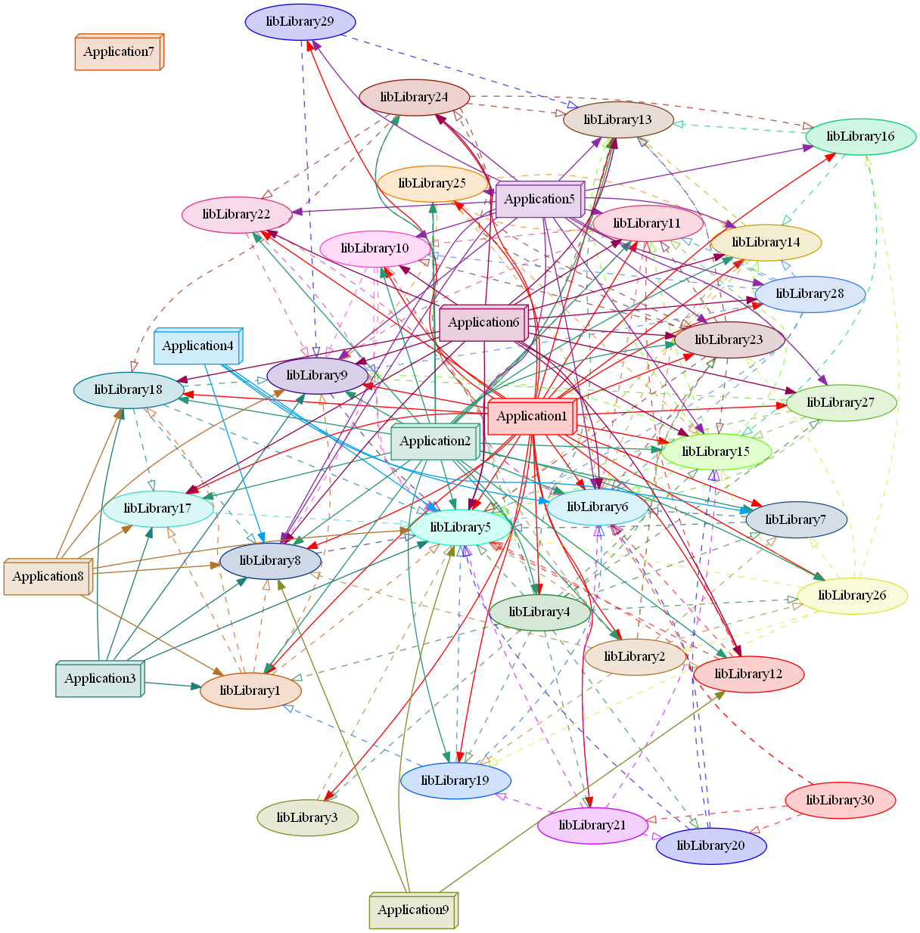
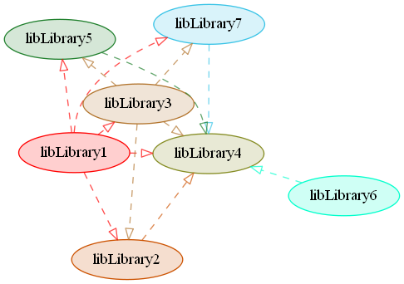
“Black Box” Mentality:
Iterating on the Solutions

Slide 64
Ongoing Areas of Research

Slide 65
Ongoing Areas of Research
Build control in GUI:
  Start build
  Stop build
  Rebuild
  Change targets, architectures, projects to build
  Leave GUI open while you work, just press go to build

Slide 66
Ongoing Areas of Research
Build History and Statistics View
  Graphs of past build times
  Average, high, low times
  Graphs showing time distributions
  Average number of files built
  Build success and failure rates
  Average error/warning count per build

Slide 67
Ongoing Areas of Research
Improving build preparation time
  Header cache is the reasonable way to do this; manually and recursively checking #includes is slow
    First attempt at this caused problems in some situations
  Ninja relies on the compiler to do this. Chunks make that a bit more complicated, but it should still be feasible.
    With plugin system, manual parsing and header cache generation still required as a fallback for compilers that don’t support this option

Slide 68
Ongoing Areas of Research
Automatic Build Analysis
  Using historical build times, automatically reorder projects to improve build speed
  Intelligent analysis of estimated build times based on past data

Slide 69
Ongoing Areas of Research
Generic Plugins
  Event-based plugins for generic tasks
  Example: moc process for Qt projects
  Enables common build events to be shared between projects and between teams

Slide 70
Ongoing Areas of Research
Feature Verification
  “./configure” built into build process
  Test features and output autoconf-compatible config.h
  Only perform tests explicitly requested by makefile
  Only test if config.h does not exist or compiler has changed
  Automatic switching between config.h files per-toolchain, per-architecture
  Example: Detecting pthreads, or switching between similar features such as epoll, kqueue, and IOCP

Slide 71
How To Try CSBuild
These techniques can be used anywhere, but CSBuild provides a reference implementation and a test bed
  MIT license, compatible with any project
  Currently in late beta - a few bugs and missing features still being dealt with
  Downloads and documentation, as well as this deck, are available at www.csbuild.org
  Also available through `pip install csbuild`
    Pip is available at https://pypi.python.org/

Slide 72
Questions?
Jaedyn Kitt Draper
www.csbuild.org
questions@csbuild.org

Slide 73
Resources
CSBuild: www.csbuild.org
pip:
  https://pypi.python.org/pypi/pip
  https://pip.pypa.io/en/latest/installing.html
CMake: http://www.cmake.org/
Premake: http://industriousone.com/premake
GYP: https://code.google.com/p/gyp/
Jam: http://www.perforce.com/resources/documentation/jam
boost.build: http://www.boost.org/boost-build2/
Scons: http://www.scons.org/
Ninja: http://martine.github.io/ninja/

